Slide 1
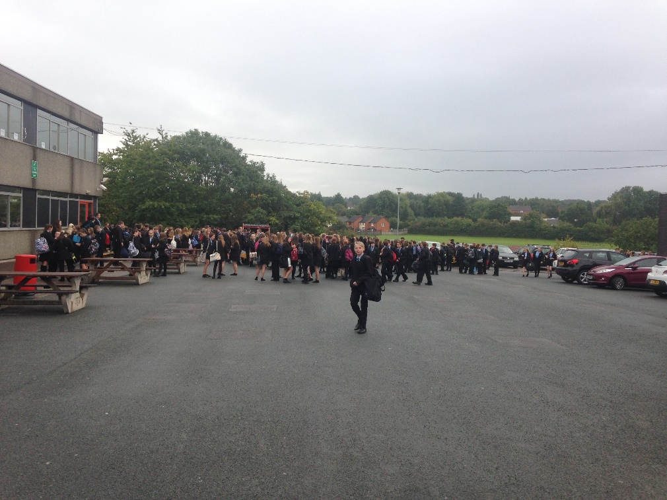
1. What are the 10 most important rights a young person has today?

Slide 2

What is a right?

