Slide 1
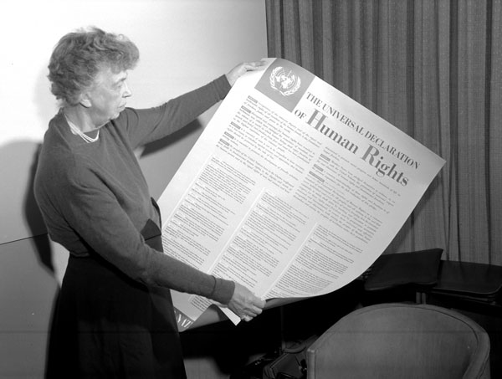
What can you remember about rights from last week?

Slide 2

What is the Universal Declaration of Human Rights?

Slide 3
Are these articles still relevant for people in 2015, why/why not?

