Slide 1
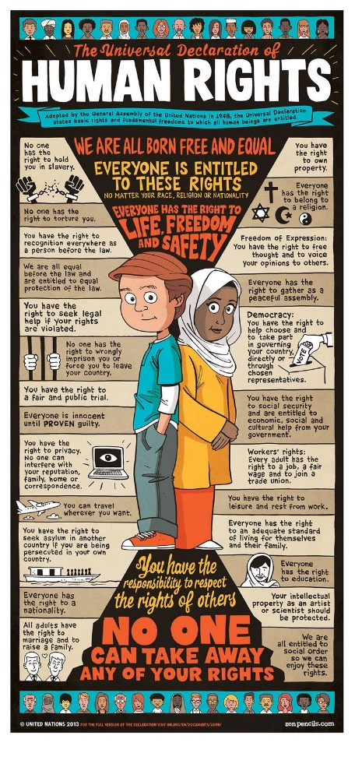
What do you remember about the Universal Declaration of Human Rights – Which articles do you still recall?

Slide 2

How does the UDHR work?

Slide 3
Should each country be allowed to set its own laws with no interference from other countries/the UN??
Agree
Disagree

