Slide 1
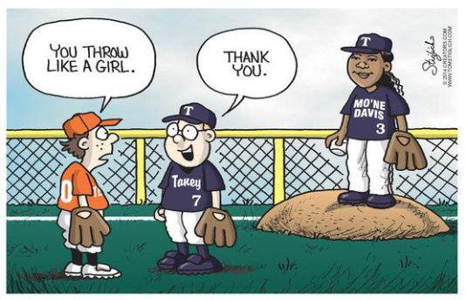
Like a girl
Breaking out of the man box

Slide 3
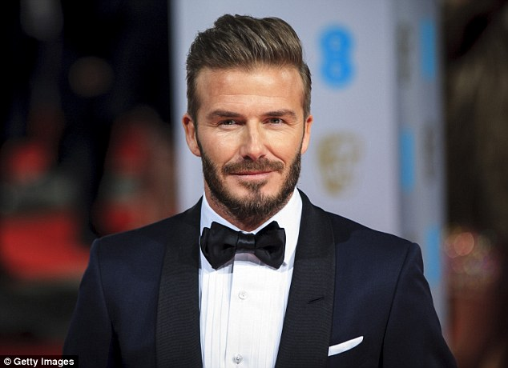
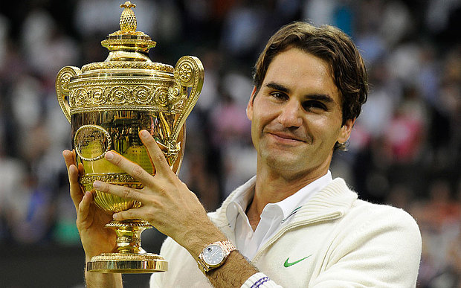
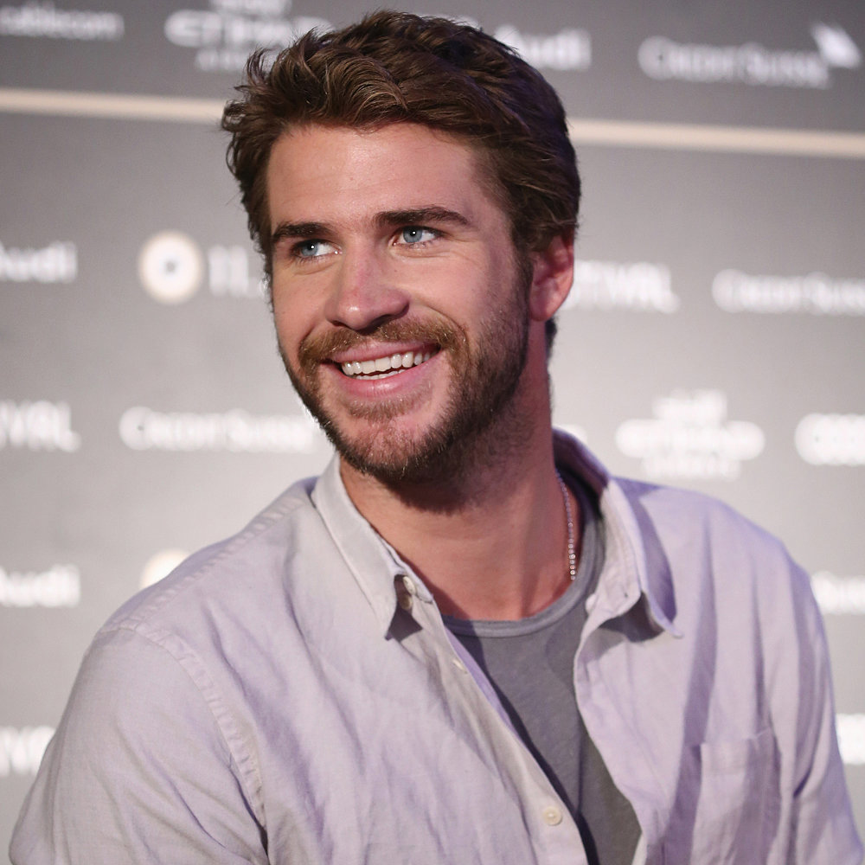
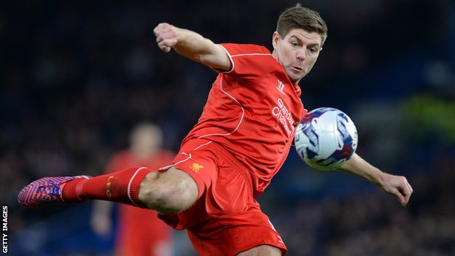
Who would you most like to be Why?

Slide 4
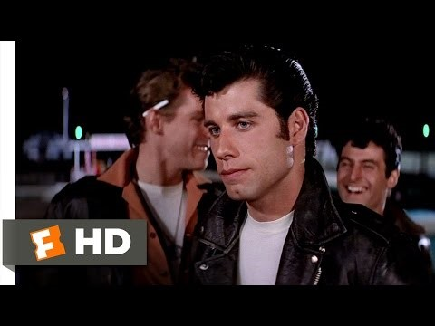

Slide 5
What does the video teach us about how boys are socialised?

Slide 6
Man box – act like a man
What does it mean, to be a MAN?
How is a man supposed to behave in sports, business, on a date, in a relationship?
What kind of emotions are boys supposed to have?
How are boys expected to express their emotions?
What kind of toys are boys expected to play with?
What kind of activities are boys expected to participate in?
How are boys expected to look? To dress?
Who are boys supposed to be attracted to?
Remember to look at these in regards to socialisation, not what you might think.
What happens if boys/men step outside this?
What might happen to them?

Slide 7
Opposite world
According to this reading, who is in control, men or women?
How do you know?
What rules have the group in control created? What are the beliefs that led to these rules?
What would it be like to grow up in this world, male or female?
How are women restricted in this world? How are men restricted?
Would you rather be male or female in this world? Why?

Slide 8


