Slide 1
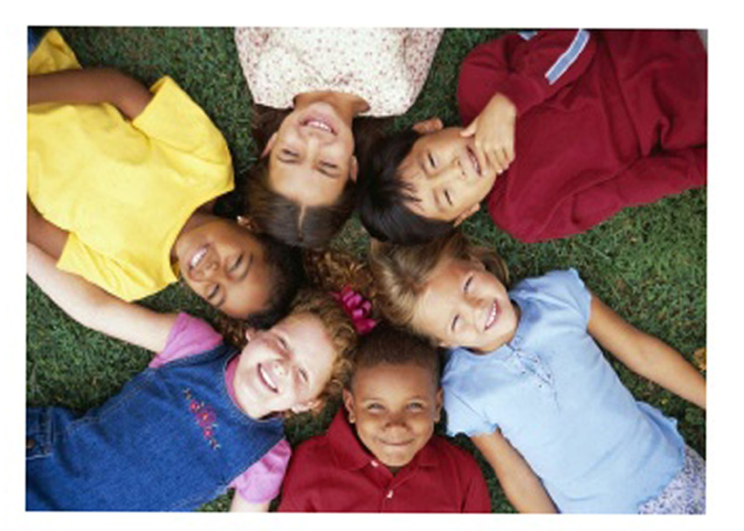
CHILD RIGHTS
THEY ALSO HAVE THE RIGHT TO LIVE AND HAVE EDUCATION

Slide 2
WHAT ARE RIGHTS?
Rights are legal, social, or ethical principles of freedom or entitlement; that is, rights are the fundamental normative rules about what is allowed of people or owed to people, according to some legal system, social convention, or ethical theory. Rights are of essential importance in such disciplines as law and ethics, especially theories of justice and deontology.

Slide 3
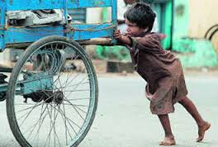
TYPES OF RIGHTS…
Right to equality,
Right to freedom,
Right against exploitation,
Right to freedom of religion,
Cultural and Educational rights, and
Right to constitutional remedies for enforcement of Fundamental Rights.

Slide 4

WHAT ARE NATURAL RIGHTS?
Natural rights are those not contingent upon the laws, customs, or beliefs of any particular culture or government, and therefore universal and inalienable (i.e., cannot be sold, transferred, or removed). The theory of natural law is closely related to the theory of natural rights.

Slide 5

WHAT ARE LEGAL RIGHTS?
Legal rights are, clearly, rights which exist under the rules of legal systems or by virtue of decisions of suitably authoritative bodies within them. They raise a number of different philosophical issues.

Slide 6
WHAT ARE HUMAN RIGHTS AND THERE PRINCIPLES ?
WHAT ARE HUMAN RIGHTS ?
Human rights are rights inherent to all human beings, such as our nationality, place of residence, sex, national or ethnic origin, color, religion, language, or any other status. We are all equally entitled to our human rights without discrimination. These rights are all interrelated, interdependent and indivisible.
TO BE CONTINUED………..

Slide 7
PRINCIPLES OF HUMAN RIGHTS……
Human rights must be afforded to everyone,
Human rights are indivisible and interdependent,
People have a right to participate in how decisions are made,
Governments must create mechanisms of accountability,
Transparency, that governments must be open about all information,
Human rights must be guaranteed without discrimination of any kind.

Slide 8
WHAT ARE CHILD RIGHTS ?
Children's rights are the human rights of children with particular attention to the rights of special protection and care afforded to minors, including their right to association with both parents, human identity as well as the basic needs for food, universal state-paid education, health care ...

Slide 9
WHY DO WE NEED CHILD RIGHTS ?
Rights are protected choices
Only those capable of exercising choices can be right-holders
Children are incapable of exercising choice
Children are not right-holders
Adults have duties to protect the important interests of children
Rights and duties are correlative
Children are right-holders

Slide 10
SOME OF THE CHILD RIGHTS…
Article 1: Definition of a child.
Article 2: Children must be protected from discrimination.
Article 3: The best interests of the child (taking into account the rights and duties of parents).
Article 4: Legislative measures to implement the treaty.
Article 5: The rights of parents.
Article 6: The right to life.
Article 7: The child's right to birth registration.
Article 8: The child's right to a name, nationality and family relations.

Slide 11
HISTORY OF CHILD RIGHTS…
Early European notions of what would now be recognized as children's rights emphasized both children's need for special protection and their place in society within families and schools, but not in the workplace. Although these ideas were current throughout the nineteenth century (in child labor reform for example) the first identification of children as subjects of rights, rather than objects of concern, is usually associated with the work of Eglantine Jebb. One outcome of this splendid Edwardian lady's experiences in charitable work with the Macedonian Relief Fund during the Balkan War of the early twentieth century was that, at the outbreak of the First World War, she declared herself a pacifist. This was not a popular decision among the jingoistic British public, but she remained stalwart, insisting that "all wars are waged against children.

Slide 12
CHILD RIGHTS
INDIA
Right to Survival - to life, health, nutrition, name, nationality
Right to Development - to education, care, leisure, recreation, cultural activities
Right to Protection - from exploitation, abuse, neglect
Right to Participation - to expression, information, thought, religion
UNITED KINGDOM
Prenatal and Postnatal Care
Healthcare: Children and Consent
Education
Curriculum
Discipline

Slide 13
AGENCIES FOR SAVING CHILD RIGHTS IN U.K.
Action on Rights for Children
Child Rights Information Network
Save the Children
National Society for the Prevention of Cruelty to Children
Children's Rights Alliance for England

Slide 14
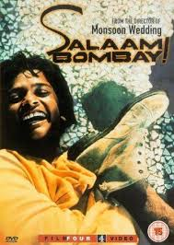

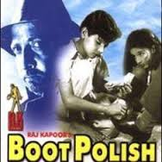
STEPS TAKEN TO SPREAD AWARENESS FOR CHILD RIGHTS ?
Movies
Movies can play a major role in spreading awareness. For E.g..

Slide 15

THE STUDENTS INVOLVED:
1.ADITYA SINGH
2.AKHIELESH M.
3.AKSHAT DUANDIYAL
4.ANSHUL AGGARWAL

