Slide 1
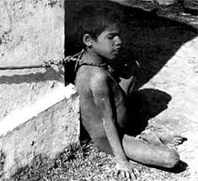
ChIlD
RiGhTs

Slide 2
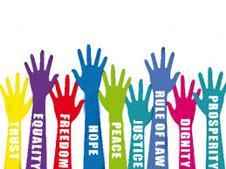
What is a right??
A right is the sovereignty to act without the permission of others. The concept of a right carries with it an implicit, unstated footnote: you may exercise your rights as long as you do not violate the same rights of another—within this context, rights are an absolute must.
Animals do not have rights. Rights only apply to beings who are capable of thought, capable of defining rights and creating an organized means. Government protects such rights.

Slide 3
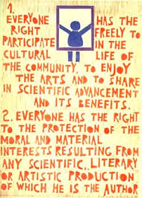
Types of rights

Slide 4

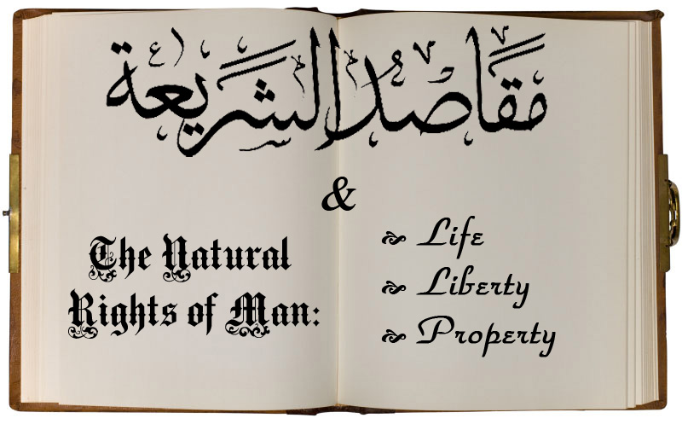
Natural Rights
Natural rights refer to the rights conferred on all individuals by the natural law. It is the fundamental right found in all civilized nations. All men and women are entitled to such rights, without interference by the state.

Slide 5

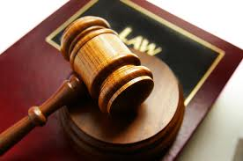
Legal Rights
Legal Rights are the rights which exits under the rules of legal systems or the virtue of decisions of suitably authoritatives bodies within them

Slide 6
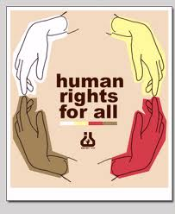
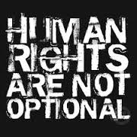
Human rights are rights inherent to all human beings, whatever our nationality, place of residence, sex, national or ethnic origin, colour, religion, language, or any other status.
We are all equally entitled to our human rights without discrimination. These rights are all interrelated, interdependent and indivisible.Universal human rights are often expressed and guaranteed by law
HUMAN RIGHTS

Slide 7
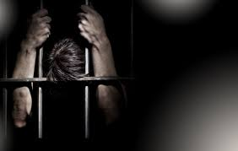
Universality: Human rights must be afforded to everyone, without exception.
Indivisibility: Human rights are indivisible and interdependent, which means that in order to guarantee civil and political rights, a government must also ensure economic, social and cultural rights.
Participation: People have a right to participate in how decisions are made regarding protection of their rights.
Accountability: Governments must create mechanisms of accountability for the enforcement of rights.
Transparency: Transparency means that governments must be open about all information and decision-making processes related to rights.
Non-Discrimination: Human rights must be guaranteed without discrimination of any kind.
HUMAN
RIGHTS
PRINCIPLES

Slide 8
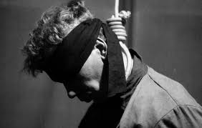
LIST OF HUMAN RIGHTS
Right to Equality
Freedom from Discrimination
Right to Life, Liberty, Personal Security
Freedom from Slavery
Freedom from Torture and Degrading Treatment
Right to Recognition as a Person before the Law
Right to Equality before the Law
Right to Remedy by Competent Tribunal
Freedom from Arbitrary Arrest and Exile
Right to Fair Public Hearing
Right to be Considered Innocent until Proven Guilty
Freedom from Interference with Privacy, Family, Home and Correspondence
Right to Free Movement in and out of the Country
Right to Asylum in other Countries from Persecution
Right to a Nationality and the Freedom to Change It
Right to Marriage and Family
Right to Own Property
Freedom of Belief and Religion
Freedom of Opinion and Information
Right of Peaceful Assembly and Association
Right to Participate in Government and in Free Elections
Right to Social Security
Right to Desirable Work and to Join Trade Unions
Right to Rest and Leisure
Right to Adequate Living Standard
Right to Education
Right to Participate in the Cultural Life of Community
Right to a Social Order that Articulates this Document
Community Duties Essential to Free and Full Development
Freedom from State or Personal Interference in the above Rights

Slide 9
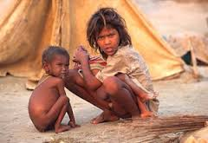
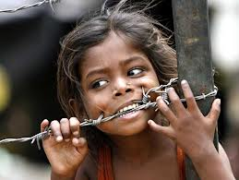
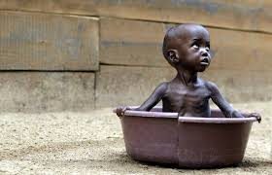
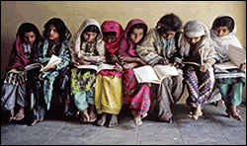
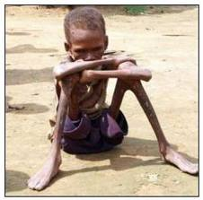
WHAT ARE CHILD RIGHTS AND WHY DO WE NEED THEM???
Child rights are the rights with particular attention to the rights of special protection and care afforded to minors,including their right to association with both
Parents , human identity as well as the basic needs for food, education, health care .It also gives equal protection of the child's civil rights , and freedom from discrimination on the basis of the child's race, gender, sexual orientation,national origin, religion, disability, color, ethnicity, or other characteristics.
We need child rights to make sure that all the children are treated fairly and that all their needs are met .Also child rights ensure that each child gets the basic amenities, he/she is secure from any kind of exploitation and turns into an asset by becoming a good and responsible citizen as “today’s children are tomorrow’s citizens”.

Slide 10
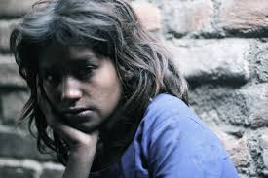
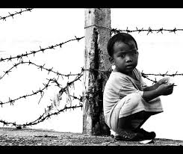
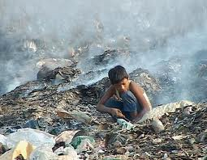
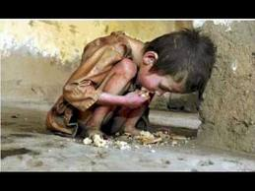
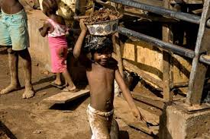
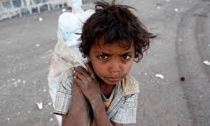
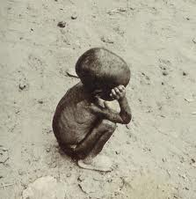
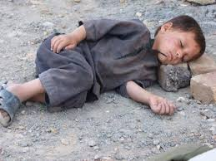
CHILD RIGHTS
The right to Education
The right to Expression
The right to Information
The right to Nutrition
The right to Health & Care
The right to protection from Abuse
The right to protection from Exploitation:
The right to protection from Neglect
The right to Development
The right to Recreation
The right to Name & Nationality
The right to Survival

Slide 11
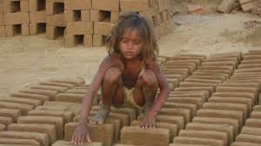
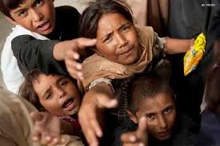
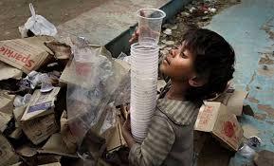

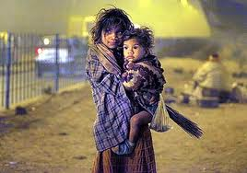
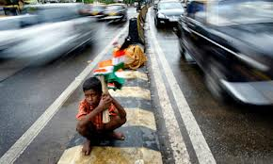
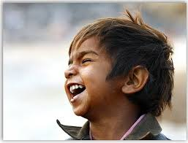
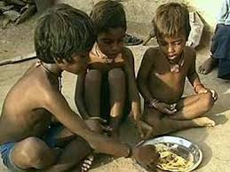
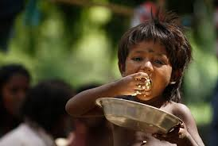
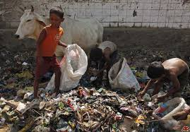
During the 50s decade that the UN Declaration of the Rights of the Child was adopted by the UN General Assembly. This Declaration was accepted by the Government of India.
As part of the various Five Year Plans, numerous programmes have been launched by the Government aimed at providing services to children in the areas of health, nutrition and education.
In 1974, the Government of India adopted a National Policy for Children, declaring the nation's children as `supremely important assets'. The first formal charter to set out the rights of children was drafted by British social reformer Eglantyne Jebb in 1923.Jebb founded Save the Children in 1919, one of the first charities aimed at the young, to help alleviate the starvation of children in Germany and Austria--Hungary during the Allied blockade of Germany in World War I which continued after the Armistice.The SCIU also pressed the newly formed United Nations in 1946 to adopt the World Child Welfare Charter. This was achieved in 1959, when the United Nations General Assembly adopted an expanded version as the Declaration of the Rights of the Child

Slide 12
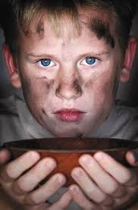

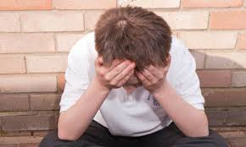
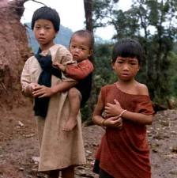
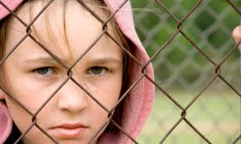
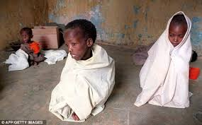
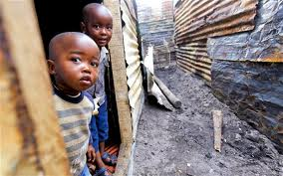
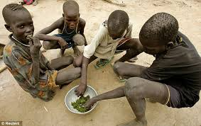
From the late 16th century to the mid 20th century, a series of Poor Laws gave increasing powers to Boards of Poor Law Guardians to provide for the destitute, including children. From the late 19th century this included the right to take on the powers and duties of a parent, firstly for abandoned children, and later for the children of parents deemed 'unfit'. By the late 19th century, it became the practice to care for children by 'boarding out' with families, and an order of 1913 made it illegal to retain a healthy child under one year old in a workhouse for more than six weeks. The responsibilities of the Poor Law Guardians were taken over by local authorities in 1929. The Matrimonial Causes Act of 1857 introduced judicial divorce, and allowed the Court to make decisions regarding custody and maintenance . In 1925, the principle of equality of rights between mothers and fathers was enshrined in law, with the welfare of the child paramount. The Children and Young Persons Act 1969 introduced more compulsory measures for local authorities to take over the parental rights of a child, and brought together the concepts of 'care and control' so that children committing criminal acts could be made subject of care orders. The Prevention of Cruelty to, and Protection of, Children Act 1889 was the first statute of many to impose criminal penalties to deter mistreatment of children. The Children Act 1989 was described by the then Lord Chancellor as " the most comprehensive and far-reaching reform of child law which has come before Parliament in living memory". It is comprehensive and integrates almost all the law relating to children.

Slide 13
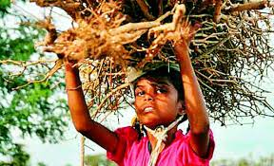
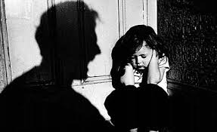
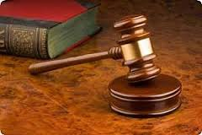
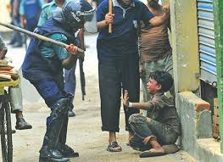

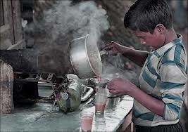
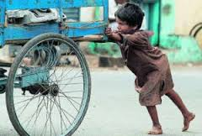
LEGISLATION FOR PROTECTION OF CHILD RIGHTS
National Policy for Children, 1974
National Charter for Children, 2003
National Plan of Action for Children, 2005
The Guardian and Wards Act (GAWA), 1890
Hindu Adoption and Maintenance Act (HAMA), 1956
The Immoral Traffic (Prevention) Act, 1986
The Child Labour (Prohibition and Regulation) Act, 1986
Guidelines and rules for Adoption of a Child, 1995
The Commissions for the Protection of Child Rights Act, 2005
The Juvenile Justice (Care and Protection of Children) Act, 2000 and Amendment Act, 2006

Slide 14
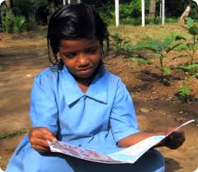
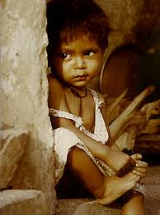
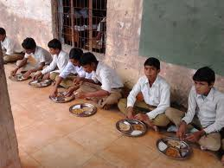
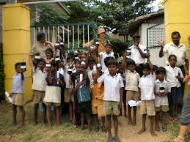
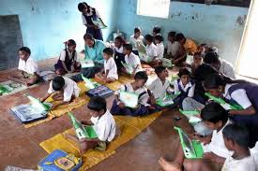
Agencies for welfare and
protection of child rights
Child Protective Services
Delhi Commision for Protection of Child Rights
Bal Sahyog
Pratidhi
Holy Cross
Make a wish foundation
Apna ghar
Onvya
Butterfly
UNHCR
National protection and Service agency

Slide 15
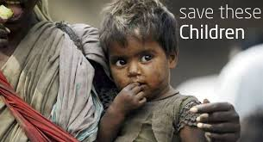
WAYS TO SPREAD AWARENESS
ON CHILD RIGHTS
THROUGH CAMPAIGNING
THROUGH SOCIAL NETWORKING SITES
THROUGH POSTERS
THROUGH STREET SHOWS

Slide 16












WE WILL BRING
THE CHANGE

Slide 17

THANK YOU

