Slide 1
Welcome -
Have a cup of tea/coffee and a cake.

Slide 2

Who are you?
On the flip chart paper write a description of you – what best describes you.
You must use the letter of your first name for the beginning of your description
E.g. Bonkers Brian

Slide 3
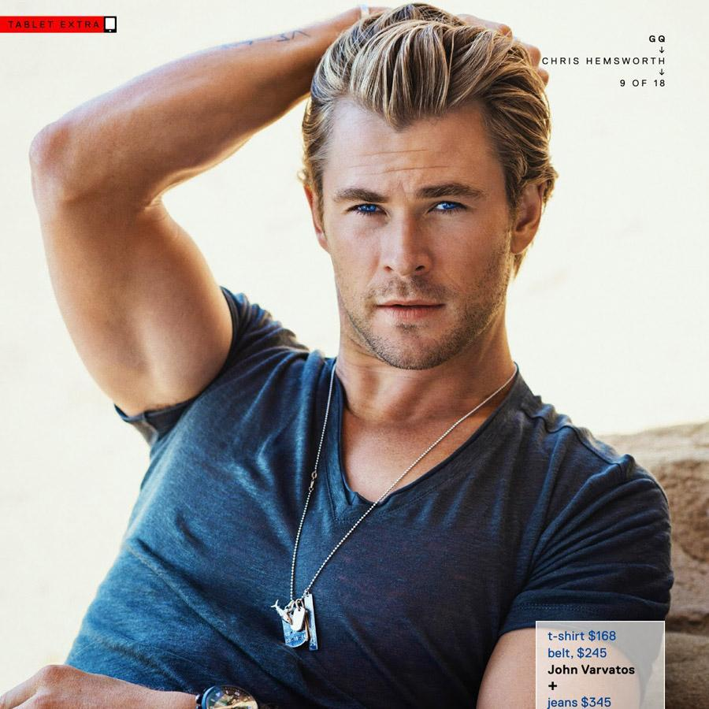
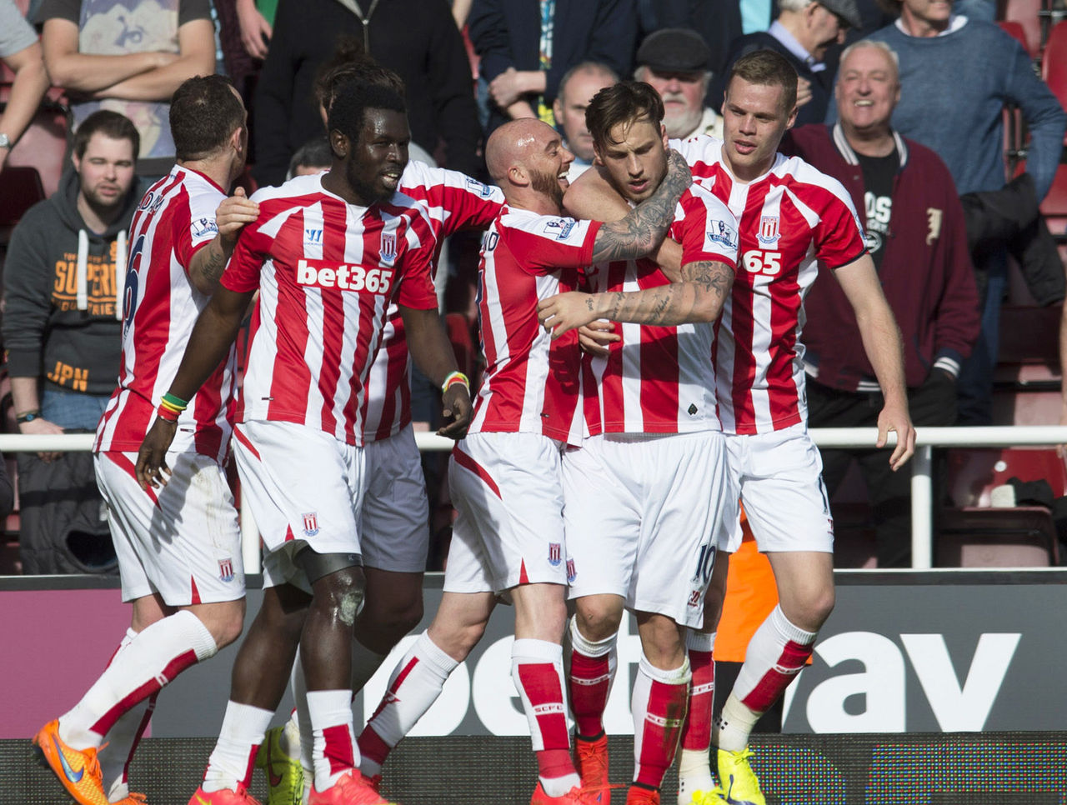
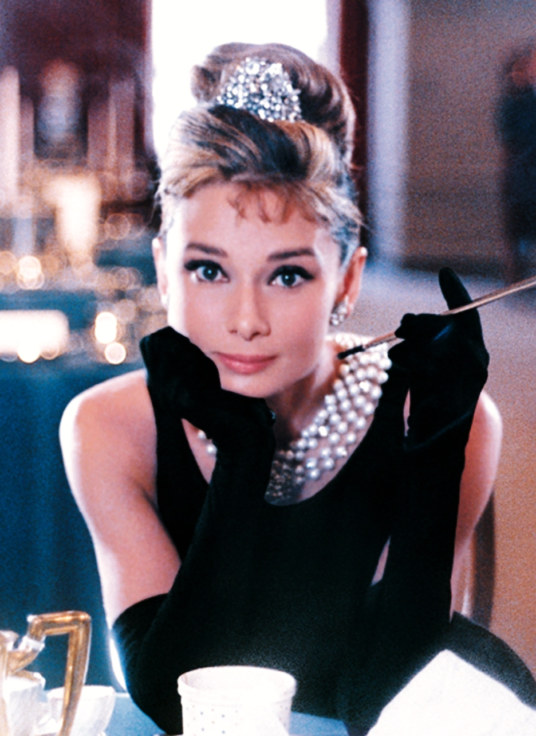
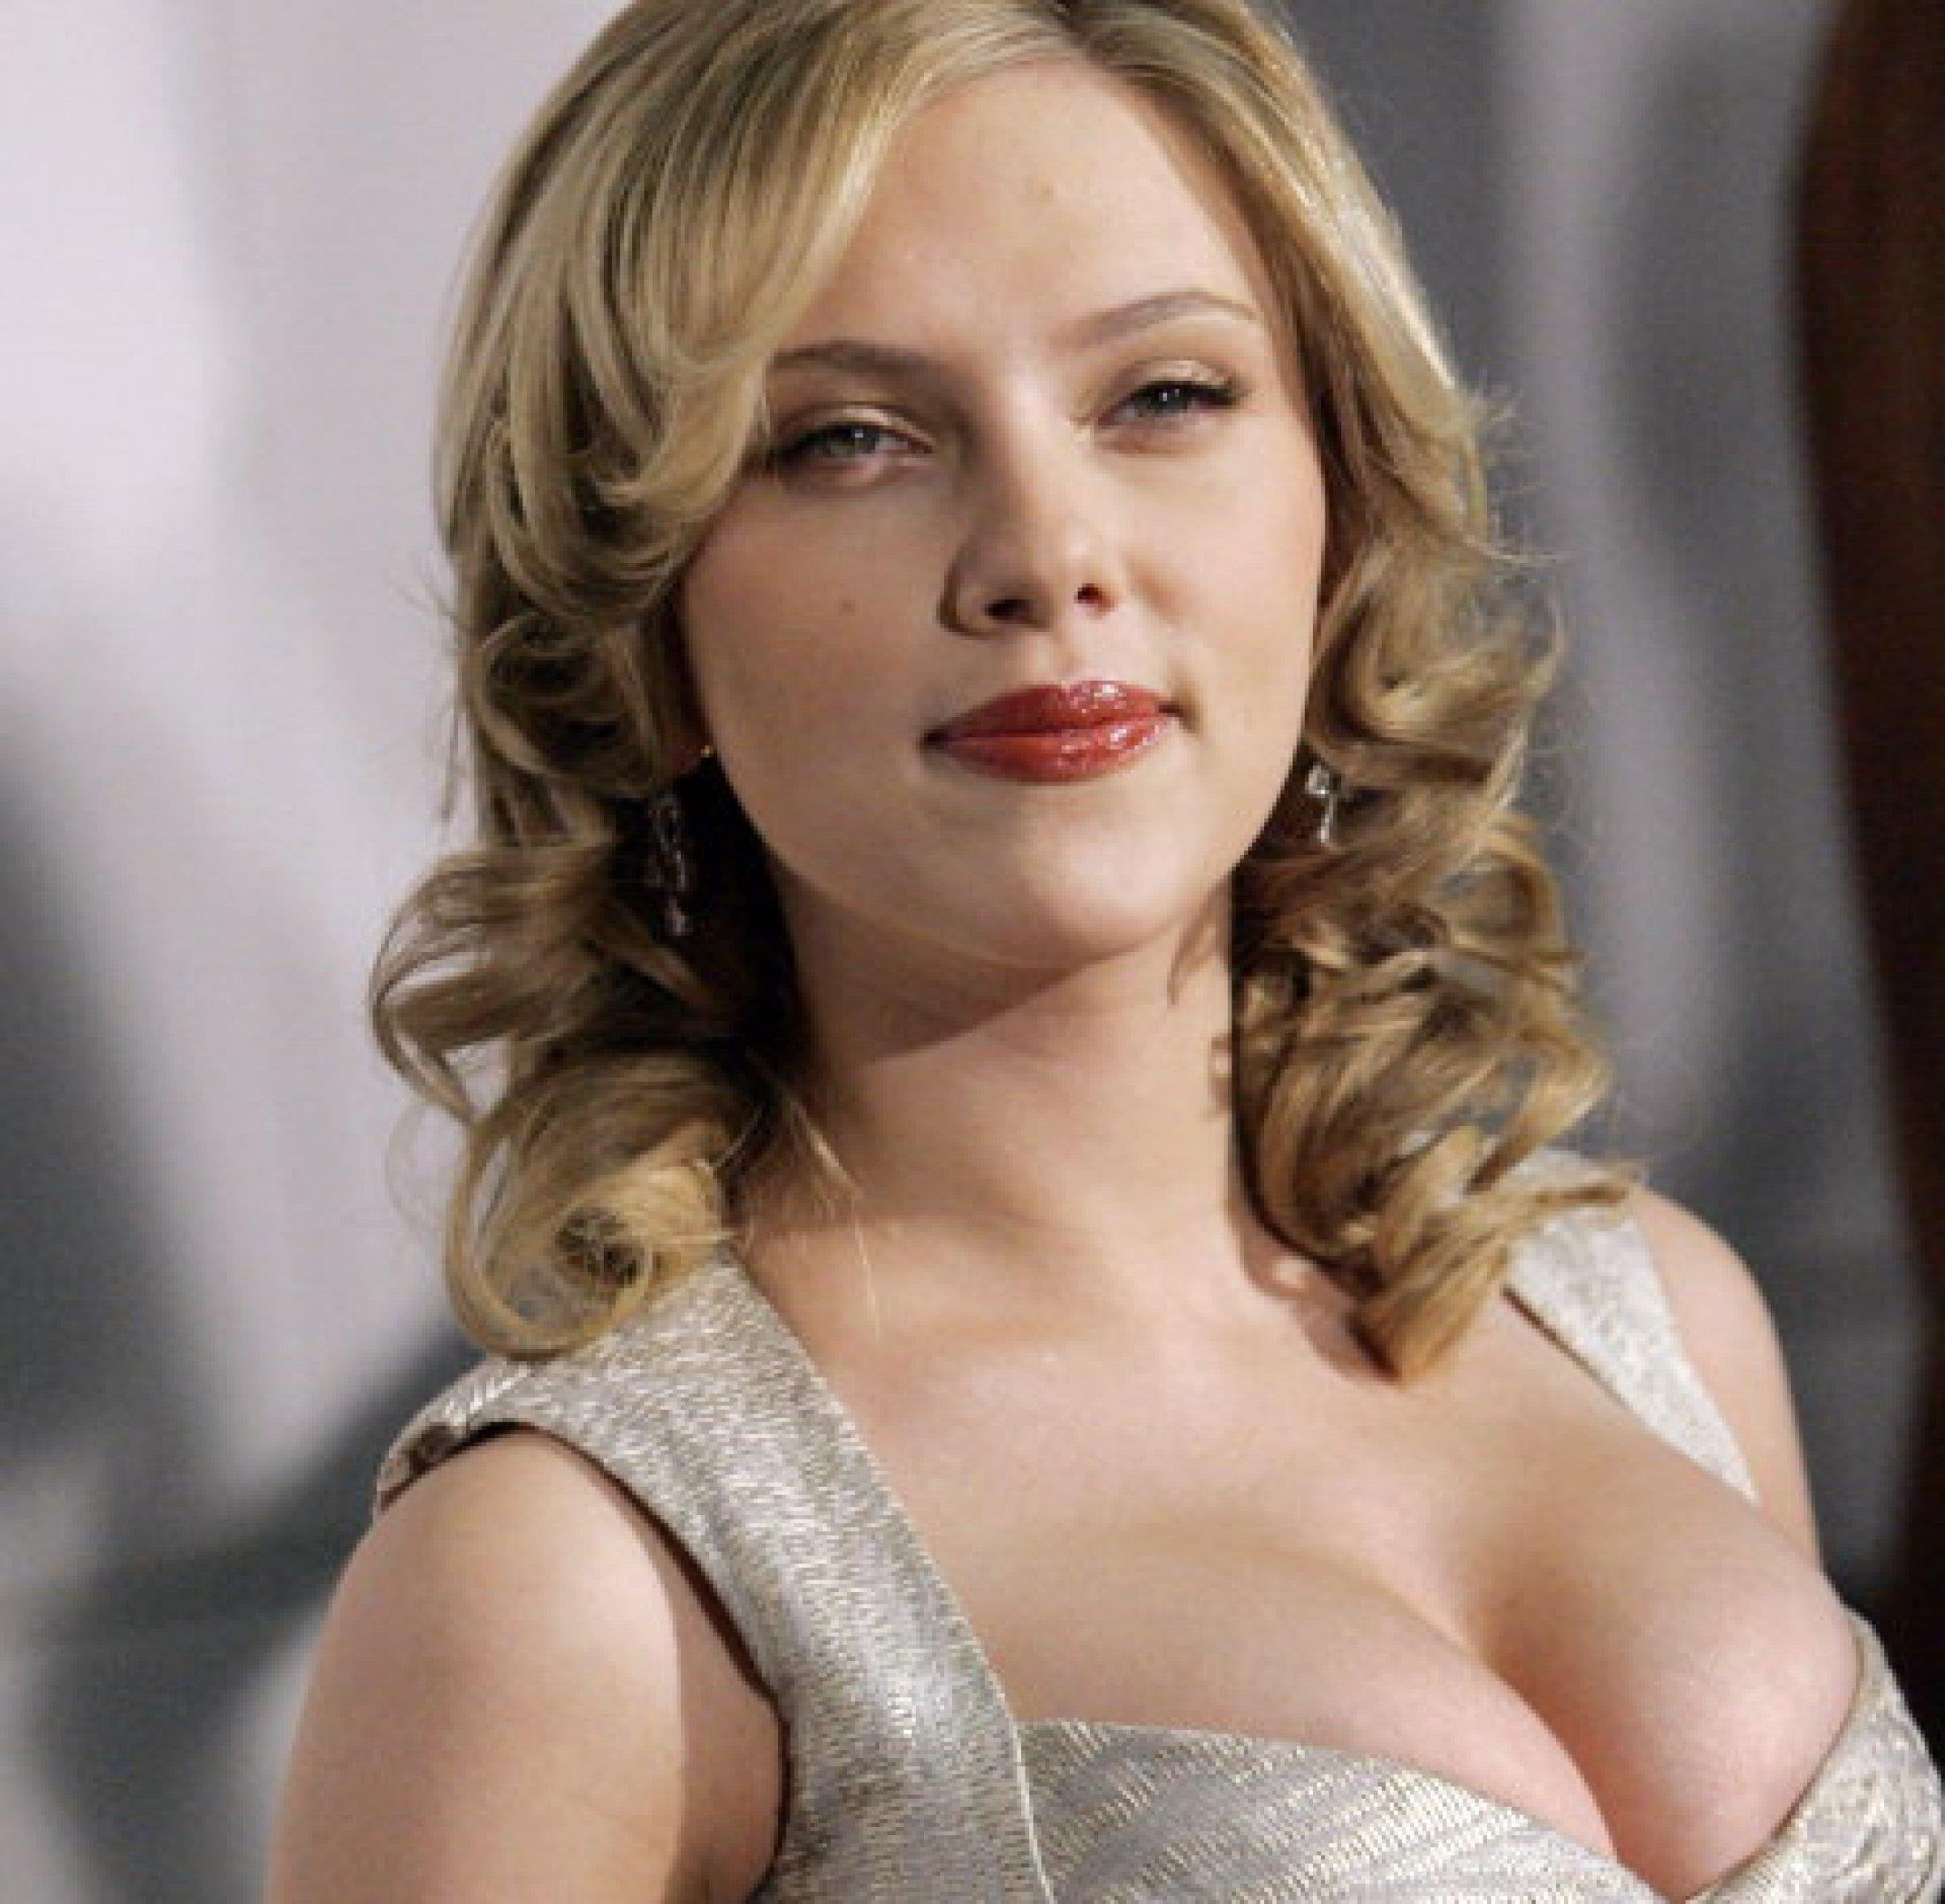
Who would you most like to be Why?

Slide 4
Some guidelines - for today and when you deliver to year 8.
Respect difference of opinion
Listen to one another
No – put downs
Open to new ideas
Respect the person – disagree with the comment/idea

Slide 6
Opposite world
According to this reading, who is in control, men or women?
How do you know?
What rules have the group in control created? What are the beliefs that led to these rules?
What would it be like to grow up in this world, male or female?
How are women restricted in this world? How are men restricted?
Would you rather be male or female in this world? Why?

Slide 7
Gender?

Slide 8
Socialisation

Slide 9
Man box – act like a man
What does it mean, to be a MAN?
How is a man supposed to behave in sports, business, on a date, in a relationship?
What kind of emotions are boys supposed to have?
How are boys expected to express their emotions?
What kind of toys are boys expected to play with?
What kind of activities are boys expected to participate in?
How are boys expected to look? To dress?
Who are boys supposed to be attracted to?
Remember to look at these in regards to socialisation, not what you might think.
What happens if boys/men step outside this?
What might happen to them?

Slide 10
Lady box – act like a Lady
What does it mean, to be a LADY?
How is a lady supposed to behave in sports, business, on a date, in a relationship?
What kind of emotions are girlss supposed to have?
How are girls expected to express their emotions?
What kind of toys are girls expected to play with?
What kind of activities are girls expected to participate in?
How are girls expected to look? To dress?
Who are girls supposed to be attracted to?
Remember to look at these in regards to socialisation, not what you might think.
What happens if girls/women step outside this?
What might happen to them?

Slide 11


Slide 12
What does the video teach us about how boys are socialised?

Slide 14
What does the video teach us about how girls are socialised?

Slide 15
After break – preparing a ‘gender lesson’ for year 8
What should we prepare?
What message are we trying to get across?
Should we include messages from the media?

Slide 16
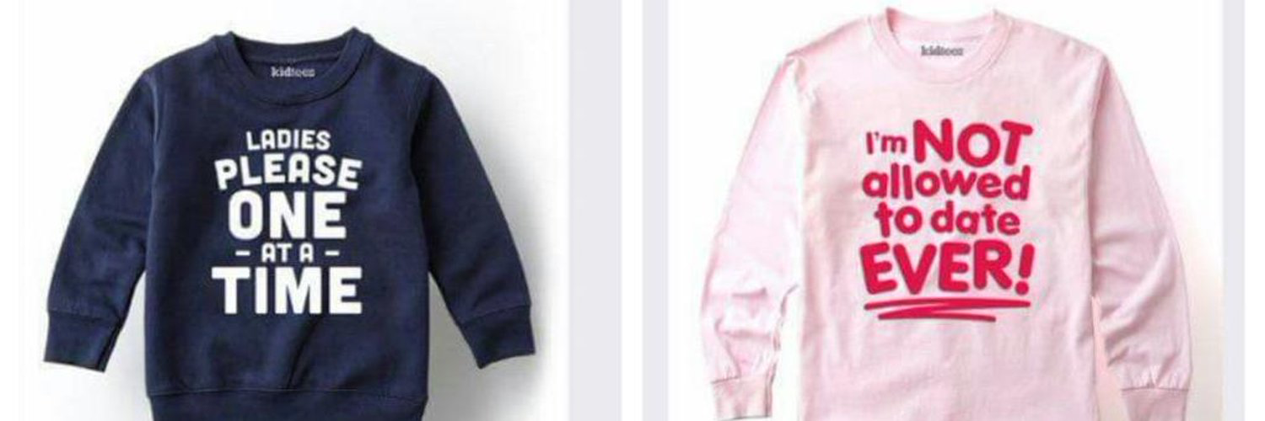
What do these pictures suggest about gender stereotypes?

Slide 17

For girls?

Slide 18
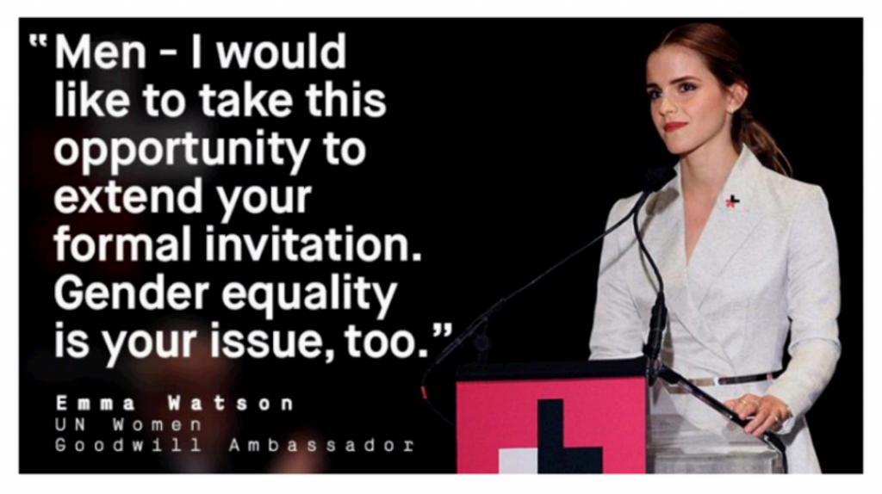
For boys?

Slide 19

Well?

Slide 20
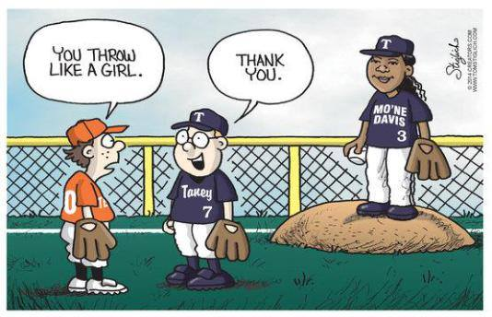
Like a girl!!

