Slide 1
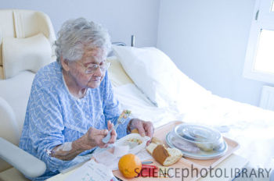
One day…..
Old People / Senior Citizens / Pensioners / The Elderly

Slide 2
Learning Outcomes
All will have a greater understanding of old age and activities and feelings that the elderly experience
Most will be able to recognise good and poor treatment of the elderly and ‘empathise’ with their position in society
Some will question your own preconceptions and re-evaluate what ‘Old age’ means to you
Some of the class will take part in some active Citizenship this Christmas

Slide 3
Click me
Once we were young

Slide 4
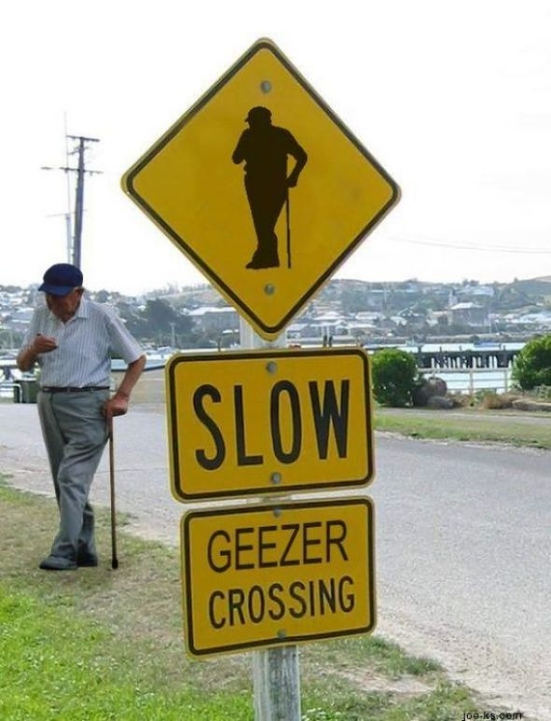
Old people are, well, old

Slide 5
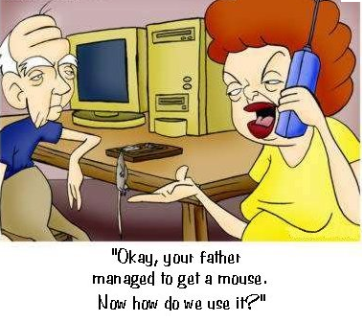
And maybe find the pace of life tough

Slide 6
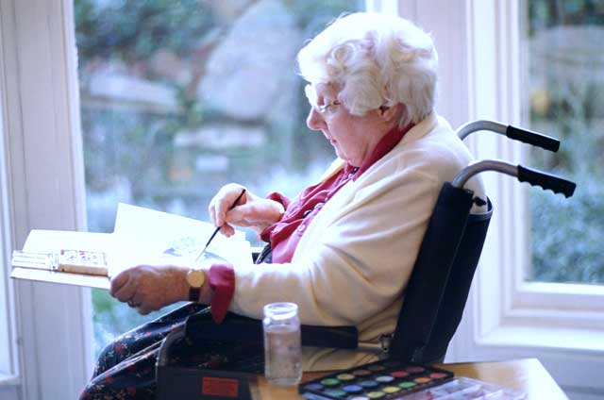
The pace of their life slows down

Slide 7
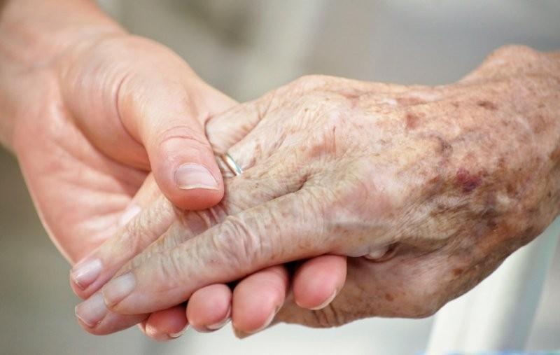
and of course the body deteriorates

Slide 8
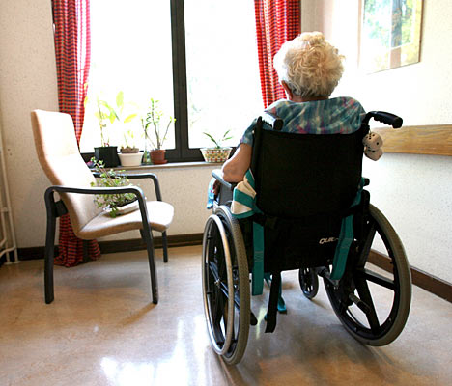
Just like you, the elderly don’t want to be alone

Slide 9
BUT…..

Slide 10
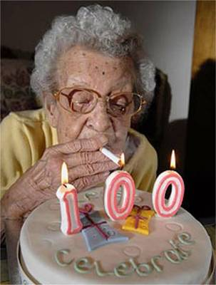
they have experienced a lot

Slide 11
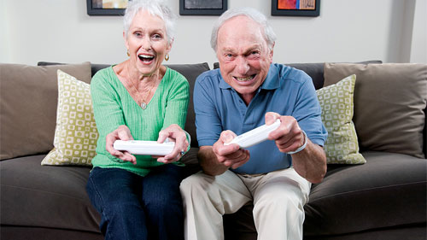
And are still prepared to learn

Slide 12
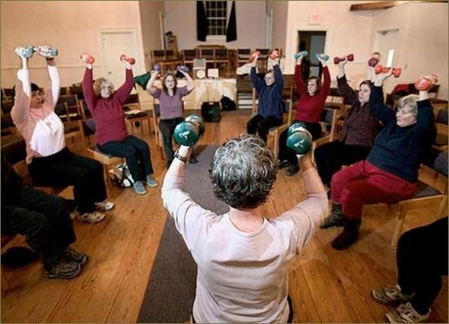
They like to exercise…

Slide 13
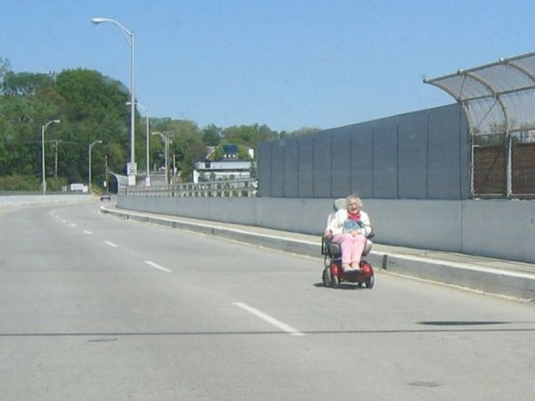
…and get about

Slide 14
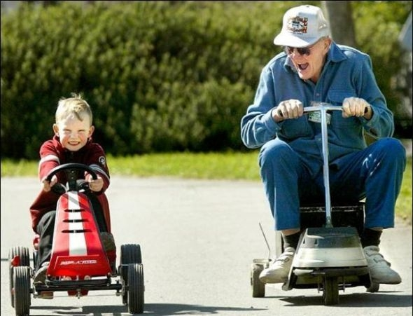
the mind often still says ‘yes’

Slide 15
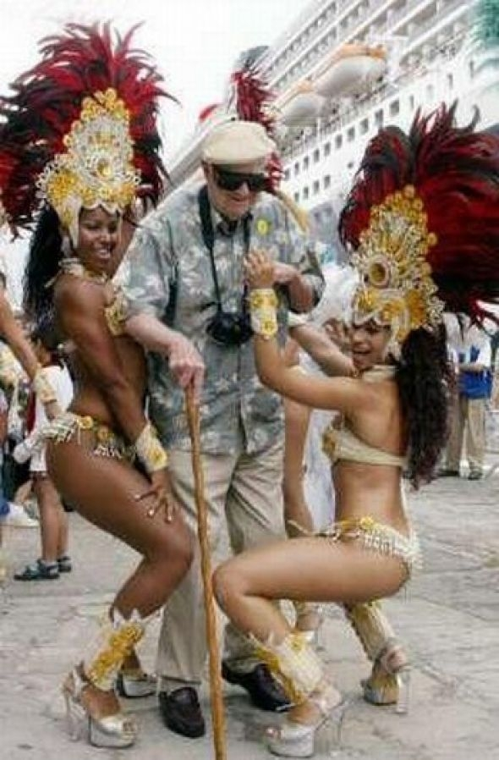
Even when the body says ‘No’

Slide 16
Oh, and by the way
We’ll all be old one day

Slide 17
In your exercise books or on paper
Separate the page into 2 columns
On one side write all the things could be ‘cool’ about old age
Eg. Being able to remember parts of History that youngsters can’t
Being able to travel free
And on the other side the things that are ‘not so cool’
You can discuss this as a class and take notes

Slide 18
Now….
Try to put yourself in the place of an elderly Citizen walking around in Droitwich
You have:-
  experienced ‘world war’
  Had a large family (and lost many of them)
  Worked for 50 years and paid your taxes, looked after your community and seen a thousand ‘fashions’
  Forgotten more than most teenagers know

Slide 19
Write a letter before you ‘move on’…
To the ‘youth’ of Droitwich
  Praise them on what you see they do well
  Let them know what shocks and upsets you
  Tell them about your life and what you have done
  What you have learned about life and how to carry yourself through life without wasting the ‘chances’
  Let them know how ‘old folk’ like to be treated
  And how they feel when you treat them well
Write the letter in your exercise book or on paper – make sure your name is in the top right as well as signing your name at the bottom.

Slide 20
Then…get involved
Click me

