Slide 1
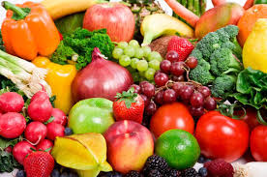
Diet
Requirements
For
Adolescent Girls

Slide 2
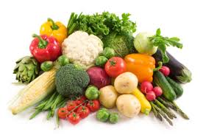
INDEX
S.NO. TOPIC SLIDE NO.
1. Why nutrition is essential from adolescence girls 1-2
2. Detailed requirements for adolescence girls 5-6
3. Eating and snacking 7
4. Healthy eating Guidelines 8-9
5. Effects of caffeine as intake 10
6. Energy Requirements 11-14
7. Variations of Energy Required 15

Slide 3
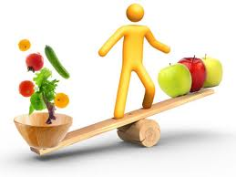
Why nutrition is essential for adolescent girls ???
Any nutritional deficiency experienced during this critical period of life can have an effect on the future health of the individual and their offspring. For example, failure to consume an adequate diet at this time can result in delayed sexual maturation and delayed or retarded physical growth. The rapid physical changes of adolescence have a direct influence on a person's nutritional needs.

Slide 4

Adolescence is a time to prepare for the nutritional demands of pregnancy and lactation that girls may experience in later life. Under-nutrition negatively affects adolescent girls by:
Affecting their ability to learn and work at maximum productivity;
Increasing the risk of poor obstetric outcomes for teen mothers;
Arresting the healthy development of future children;
Affecting sexual maturation and growth: and
Preventing the attainment of normal bone strength and the development of healthy teeth if a youth doesn't get enough calcium.

Slide 5
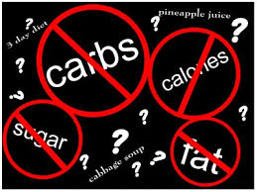
Detailed diet
Requirements for
Adolescent girls
Energy Requirement
Energy needs of adolescents are influenced by activity level, basal metabolic rate, and increased requirements to support pubertal growth and development. Adolescents need additional energy for growth and activity. Adolescent girls need approximately 2,200 calories each day.

Slide 6
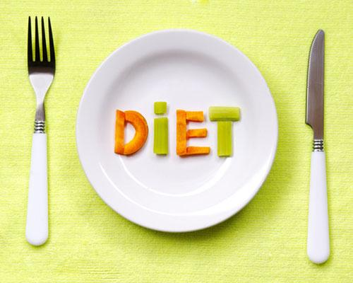
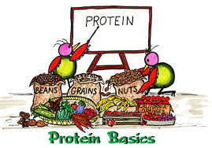
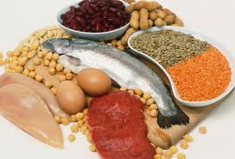
Protein
Protein needs of adolescents are determined by the amount of protein required for maintenance of existing lean body mass and the development of additional lean body mass during the adolescent growth spurt. In effect, protein is important for growth and maintenance of muscle. Adolescents need between 45 and 60 grams of protein each day. Most teens easily meet this requirement with their intake of beef, pork, chicken, eggs, and dairy products.

Slide 7
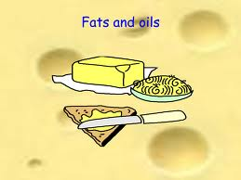

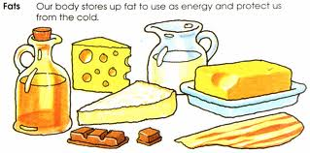
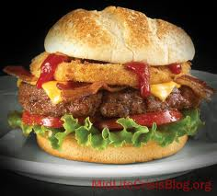
FATS AND OILS
During adolescence, dietary fat continues to play important roles as an energy source, a significant cell structural component, a precursor to agents of metabolic function and a potent gene regulator.
Effective strategies for reducing fat intake in children include the use of skim milk and choosing only lean meat.

Slide 8
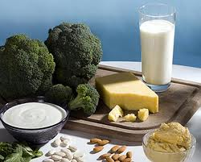
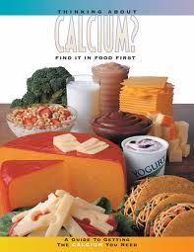
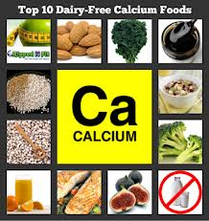
CALCIUM
It is estimated 45% of peak bone mass is attained during adolescence and so adequate calcium intake is important for the development of dense bone mass and the reduction of the lifetime risk of fractures and osteoporosis. In order to get the required 1,200 milligrams of calcium, teens are encouraged to consume three to four servings of calcium-rich foods each day. Milk provides the greatest amount of calcium in the diets of adolescents, followed by cheese, ice cream and frozen yogurt.

Slide 9
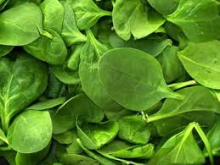
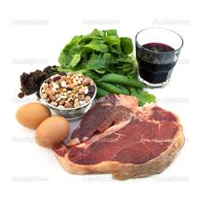
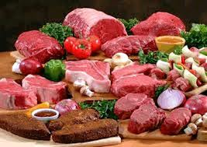
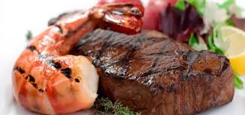
IRON
The Recommended Allowance Dietary (RDA) for iron is 12-15 milligrams (mg) per day. Good sources of iron include beef, chicken, pork, legumes (including beans and peanuts), enriched or whole grains, and leafy green vegetables such as spinach.
Iron is vital for transporting oxygen in the bloodstream. A deficiency of iron causes anaemia, which lead to fatigue,
confusion, and weakness.

Slide 10
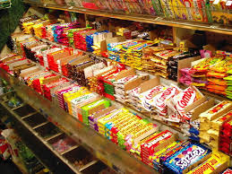
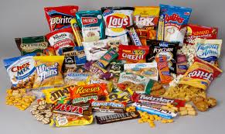
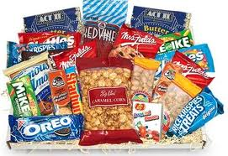

Eating and snacking patterns
Adolescents tend to eat differently than they did as children. Preoccupied with after-school activities and engagement in active social endeavours, adolescents are not always able to sit down for three meals a day. These apparent busy schedules may lead to meal skipping, snacking throughout the day, and more eating away from home.
. More importantly, eating too many fast foods can lead to weight gain and which may predispose one to diseases such as diabetes and heart disease.

Slide 11

Healthy Eating Guidelines for Girls aged 14-18 years
5-11 servings from the bread, cereals, rice, pasta, noodles group
An example of one serve is 2 slices of bread; 1 medium bread roll; 1 cup
of cooked rice, pasta or noodles; or 1 1/3 cup of breakfast cereal flakes.
4 servings from the vegetables, legumes group
An example of one serve is 75 grams or 1/2 cup cooked vegetables; 1/2 cup
cooked dried beans, peas, lentils or canned beans; 1 cup of salad vegetables;
or 1 small potato

Slide 12
3 servings of fruit
An example of one serve is 1 medium apple; 2 small pieces (150g) of fruit
(apricots, kiwi fruit, plums); 1 cup of diced fruit pieces or canned fruit; 1/2 cup
of fruit juice; or 1 1/2 tablespoons of sultanas.
3 servings from the milk, yoghurt, cheese group
An example of one serve is 250 mls of fresh milk; 250ml of calcium fortified
soy beverages; 40 grams (2 slices) of cheese; or 200g (1 small carton of
yoghurt).
1 serving from the lean meat, fish, poultry, eggs, nuts and legumes group
An example of one serve is 65-100 grams cooked meat or chicken; 2 small
chops; 2 slices of roast meat; ½ cup of cooked (dried beans); 80-120 grams of
fish fillet; 1/2 cup of peanuts (almonds); or 2 small eggs.

Slide 13
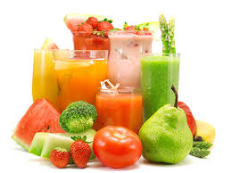
Effects of caffeine as intake is increased
Moderate amounts (less than 600 mg/day) | Large amounts (greater than 600 mg/day) | Long-term effects of large amounts (greater than 600 mg/day)
Become more alert | Get headaches | Find sleeping difficult
Heart rate increases | Feel restless and jittery | Worry more
Urinate more frequently | Feel nervous | Depression
Body temperature rises | Become delirious | Have stomach upsets
More acid produced in digestive system | Find it difficult to sleep | May become addicted to caffeine

Slide 14
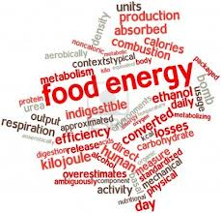
Energy requirements (kilojoules/day)
About 9,500 kJ/day (2,270 cal/day)

Slide 15
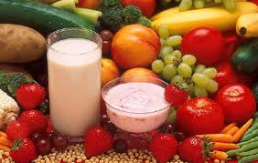
Food | Quantity | Energy (kJ) | Protein (g) | Carbohydrate (g) | Fat (g) | Salt (Sodium, mg)
Breakfast
Cereal, flake, low sugar, fortified* | 1 cup | 475 | 2.04 | 25.17 | 0.21 | 324
Skim milk | 1/2 cup | 189 | 4.68 | 6.5 | 0.13 | 57
Orange juice, no added sugar | 1 cup | 362 | 1.58 | 18.64 | 0.26 | 13
Nutritious Snack
Apple, unpeeled | 1 medium | 319 | 0.42 | 17.5 | 0.14 | 1
Carrot bran muffin | 1 | 659 | 3.36 | 21.23 | 6.15 | 273
Water bottled | 200ml | 0 | 0 | 0 | 0 | 0

Slide 16
Lunch - Ham and salad roll
Bread roll, mixed grain | Long roll | 760 | 6.08 | 31.25 | 2.6 | 353
Leg ham, fat trimmed | 2 slices | 219 | 7.69 | 0 | 2.39 | 649
Cucumber | 3 slices | 12 | 0.13 | 0.49 | 0.03 | 5
Avocado | 2 slices | 267 | 0.57 | 0.12 | 6.78 | 1
Lettuce | 1 large leaf | 6 | 0.14 | 0.06 | 0.02 | 3
Tomato | 3 slices | 30 | 0.45 | 0.86 | 0.05 | 3
Carrot, grated | 1/3 cup | 52 | 0.32 | 2.12 | 0.04 | 18
Low-fat chocolate milk | 300ml carton | 671 | 15.58 | 21.62 | 1.59 | 197
Fruit, nut & seed bar | 1 small 27g bar | 399 | 1.38 | 10.64 | 4.4 | 22

Slide 17
Nutritious Snack
Bread, wholemeal | 2 slices | 757 | 7.52 | 29.83 | 2.31 | 382
Peanut butter, no added salt or sugar | 6 teaspoons | 974 | 10.39 | 3.04 | 19.35 | 0
Low-fat vanilla yoghurt | 1 x 200g tub | 652 | 11.8 | 24.2 | 0.4 | 158
Strawberries | ½ cup | 79.2 | 1.36 | 2.16 | 0.08 | 4.8
Water | 1 cup | 0 | 0 | 0 | 0 | 0

Slide 18
Dinner - Beef and vegetable noodles
Egg noodles | 1/6 cup | 561 | 5.3 | 25.6 | 0.6 | 68
Beef, fat trimmed | 80g | 663 | 22.24 | 0 | 7.68 | 46
Vegetable oil | 1 teaspoon | 170 | 0 | 0 | 4.6 | 0
Onion | 1 small | 35 | 0.41 | 1.43 | 0.02 | 3
Garlic | 1/2 clove | 6 | 0.07 | 0.11 | 0.03 | 0
Broccoli | 1/2 cup flowerets | 54 | 1.63 | 0.62 | 0.13 | 8
Snow pea | 8 | 60 | 0.9 | 1.38 | 0.45 | 0
Oyster sauce | 1 tablespoon | 117 | 0.7 | 5.25 | 0.25 | 948
Chilli sauce | 1 tablespoon | 94 | 0.18 | 3.78 | 0.52 | 268
Low-salt soy sauce | 1 teaspoon | 9 | 0.28 | 0.14 | 0 | 184
Carrot | 1 medium | 66 | 0.42 | 2.73 | 0.05 | 20
Water | 1 cup | 0 | 0 | 0 | 0 | 0
Snack
Vanilla ice-cream | 2 scoops | 388 | 1.75 | 10 | 5.35 | 30
Chopped peanuts | 1 tablespoon | 239 | 2.48 | 0.9 | 4.73 | 0.1

Slide 19
Variation to Energy Expenditure depending on Physical Activity Level for a girl 16 years, about 1.6m in height, weighing about 54kg
Lifestyle/Exercise level | Energy requirement (kJ/day)
At rest, exclusively sedentary or lying (chair-bound or bed-bound) | 7,200kJ/day
Exclusively sedentary activity/seated work with little or no strenuous leisure activity eg office employee | 8,400-8,950 kJ/day
Sedentary activity/seated work with some requirement for occasional walking and standing but little or no strenuous leisure activity eg drivers, students | 9,500-10,100 kJ/day
Predominantly standing or walking work eg shop workers | 10,700-11,300 kJ/day
Heavy occupational work or highly active leisure eg construction workers, farmers, high performance athletes. | 11,900-13,100+ kJ/day
Lifestyle/Exercise level | Energy requirement (kJ/day)

