Slide 1


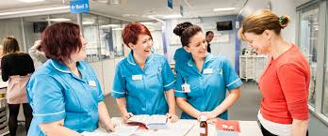

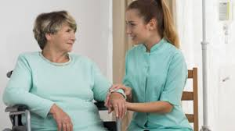
Level 1 / 2 Health and Social
KEY TEACHER: Mrs Mugridge HEAD OF DEPT: MrsDerwent

Slide 2
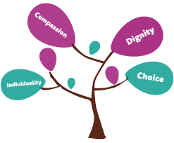
WHAT YOU WILL LEARN
Principles of care in health and social care settings.
Supporting individuals through life events.
Health promotion and how to plan your own campaign.

Slide 3

WHAT YOU WILL LEARN - Supporting individuals through life events.(Year 10)
Controlled Assessment
This unit is assessed by a Set Assignment. In this unit you will learn about growth and development through the life stages. You will also learn how to understand the needs of individuals who have been affected by life events and how to recommend support to meet their needs. Topics include:
o Topic Area 1 Life stages
o Topic Area 2 Impacts of life events
o Topic Area 3 Sources of support

Slide 4

WHAT YOU WILL LEARN - Health promotion and how to plan your own campaign.(Year 10)
Controlled Assessment
This unit is assessed by a Set Assignment. In this unit you will research health promotion campaigns and learn about their benefits to society. You will also plan and deliver your own health promotion campaign. Topics include:
o Topic Area 1 Current public health issues and
the impact on society
o Topic Area 2 Factors influencing health
o Topic Area 3 Plan and create a health promotion
campaign
o Topic Area 4 Deliver and evaluate a health
promotion campaign

Slide 5

WHAT YOU WILL LEARN - Principles of care in health and social care settings.(Year 11)
Examination
This unit is assessed by an exam. In this unit you will learn about the key topics that are important when caring for and protecting people in health and social care. Topics include:
o Topic Area 1 The rights of service users in health and social care settings
o Topic Area 2 Person-centred values
o Topic Area 3 Effective communication in health and social care settings
o Topic Area 4 Protecting service users and service providers in health and social care settings

Slide 6

WHAT YOU WILL DO IN A SEQUENCE OF LESSONS – Course Breakdown
Year 10 / 11 – 3 Lessons per week (usually one double and one single)
Develop understanding of topics through theory lessons throughout both years
Complete ongoing assessments independently during class time
Revision for exam taken in Year 11

Slide 7

WHAT YOU WILL DO IN A SEQUENCE OF LESSONS – FAQ’s
What are the similarities and differences between a Cambridge National qualification and a GCSE?
Ongoing assessments throughout both years, rather than solely assessed at the end of Year 11
GCSE qualifications and Cambridge Nationals are Level 1 and 2 qualifications. Worth the same ‘points’ as a GCSE eg. Level 2 Distinction = 7 at GSE, Level 2 Pass = 4 at GCSE
What is the qualification like?
We learn a lot through talking about the subject together. When we are working on controlled assessment units there is a lot of writing required. You will be taught a topic area and will complete a detailed written assessment on that topic before moving on. Therefore it is imperative you keep up to date with your work and excellent attendance.
Many students that take health and social care enjoy the conversational element, but also work well independently due to the heavy controlled assessment element of the course.

Slide 8
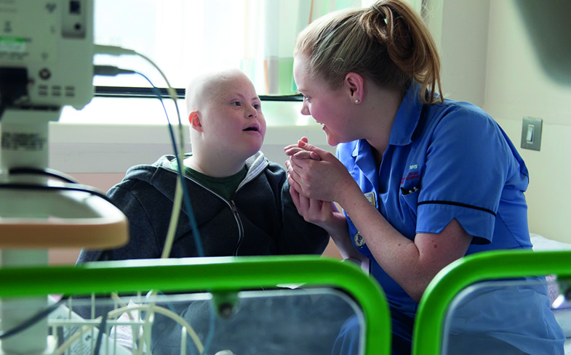
HOW YOU WILL BE ASSESSED
Three Units
R032: Principles of care in health and social care settings.
Exam Paper. Sat in Summer Year 10
Duration 1 hour 15 minutes
Worth 70 marks / 40% of qualification
R033: Supporting individuals through life stages.
Controlled Assessment completed in lessons
Worth 60 marks / 30% of qualification
R035: Health promotion campaigns
Controlled Assessment completed in lessons
Worth 60 marks / 30% of qualification

Slide 9

WHAT SKILLS YOU WILL DEVELOP AND WHERE THOSE SKILLS MIGHT TAKE YOU - Why study Health and Social Care?
The Course
Lots of group conversations
Independent and team work opportunities
Assessed through exam and coursework
Skills
Communication
Analysis and Evaluation
Organisation
Extended writing
Presenting a health promotion campaign
Note
You will need to be good at working independently and managing your time well

Slide 10

WHAT SKILLS YOU WILL DEVELOP AND WHERE THOSE SKILLS MIGHT TAKE YOU - Student Testimonials
“Health and Social Care is a great subject to take if you are willing to put in the time and energy to get a good grade, it is interesting to learn about everything on the course and I really enjoyed the lessons, even when I got stressed or didn’t understand Mrs Mugridge was able to help and guide me through it. I would recommend you take it because I enjoyed it so much I’m taking Health and Social as an A-Level.”

Slide 11

WHAT SKILLS YOU WILL DEVELOP AND WHERE THOSE SKILLS MIGHT TAKE YOU - Life after Level 1 / 2 Health and Social Care
6th form at DSHS – Health and Social Care
College
Apprenticeships
University
Abundance of career opportunities

Slide 12

WHAT SKILLS YOU WILL DEVELOP AND WHERE THOSE SKILLS MIGHT TAKE YOU - Potential careers
What jobs will this help us get in the future?
You could look at it from a 'transferable skills' point of view. By doing a qualification in health and social care you are showing potential employers that you are creative, hard working, independent, motivated, practical, patient, can work well independently and as part of team. It shows you are not just good at writing answers on an exam paper.
Potential Careers
People will always need to be cared for, regardless of age. This qualification can also be great for people choosing a career in teaching, paediatrics, health and social care, nursing, midwifery to name a few

Slide 13
We look forward to welcoming you on our course. We are happy to answer any questions you may have
Key Teacher | Head of Department
Anna Mugridge – Head of Bulman House | Sarah Derwent - Head of Home Economics
MugridgeAC@droitwichspahigh.worcs.sch.uk | DerwentSS@droitwichspahigh.worcs.sch.uk

